Slide 1
Marketing Pricing Simulation
With swarm optimization Algorithm
-Li Guo

Slide 2
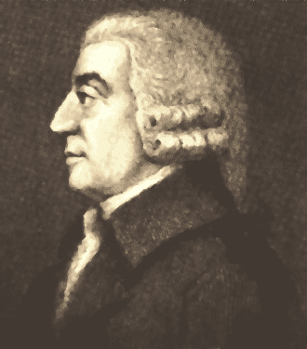
Invisible Hand & Game theory:
The invisible hand theory (Adam Smith):
The Wealth of Nations
A term to describe the unintended social benefits of individual actions.
if each consumer can choose freely what to buy and each producer can choose freely what to sell and how to produce it, the market will settle on a production distribution and product prices that are beneficial to all the individual members of a community, and hence to the overall community.

Slide 3
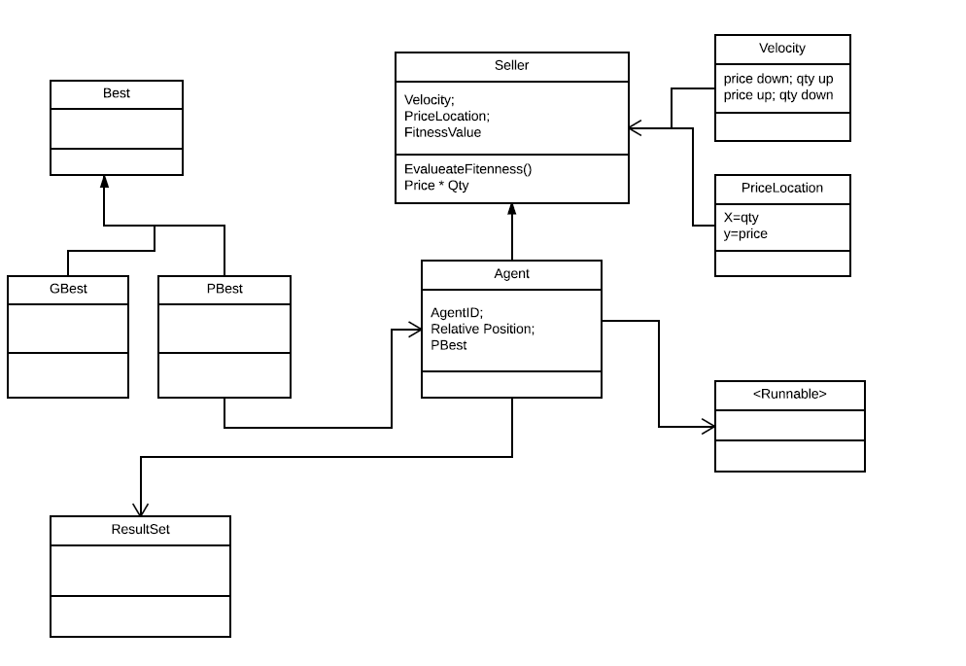
UML with main classes:
Pseudo Code
Create a swarm of agents (initiate them within desired price range and set a wanted product elasticity)
Initiate the agents and let them execute();
In execute method:
For each agent; let them keep check the other agents’ price in a range of 20*20 px and update local best;
Move toward the local best agent’s price accordingly (calculate price velocity);
Quantity if affected passively (calculate quantity based on the quantity-demand elasticity formula);
Meanwhile; update global best-optimum market price;
Paint result

Slide 4

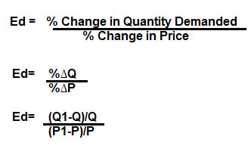
Points to Notice:
Double X-qty: quantity, how much sell will achieve
Double Y-price: how much the seller is pricing its product
Velocity for price: will be decided by sellers; based on the Game Theory
Velocity for quantity: demand-price elasticity formula

Slide 5
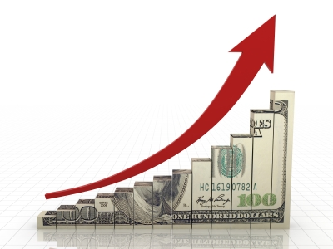
Points to Notice:
Fitness Value: Revenue = Price * Quantity of sale;
PBest:
local best: range of 20*20 px;
Gbest:
Global best: overall market;

Slide 6
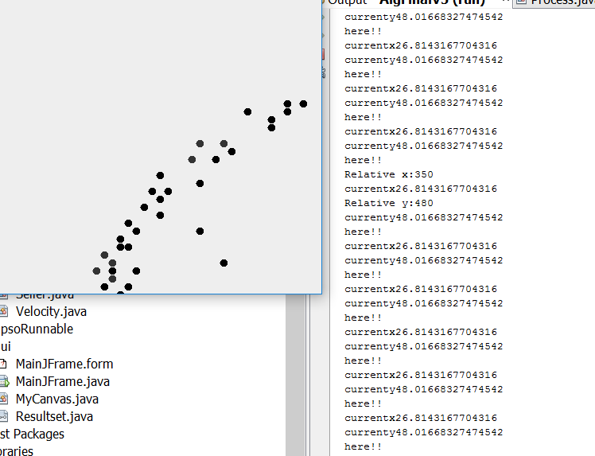
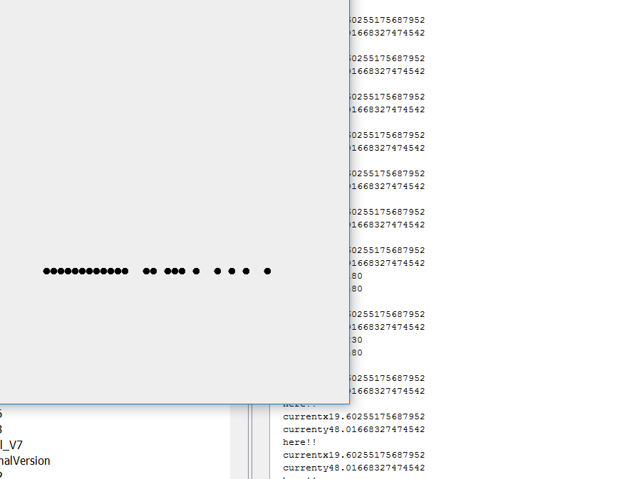
Sample results: test case 1
Before:
After:

Slide 7
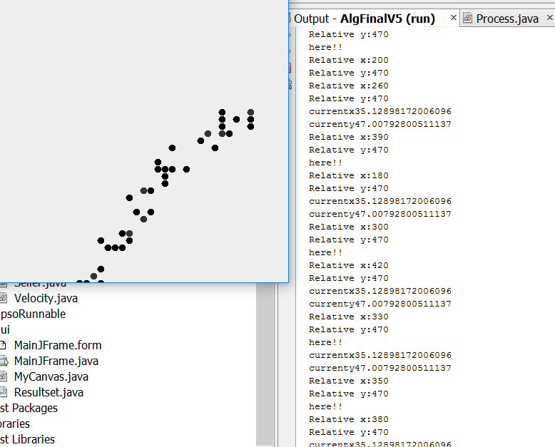
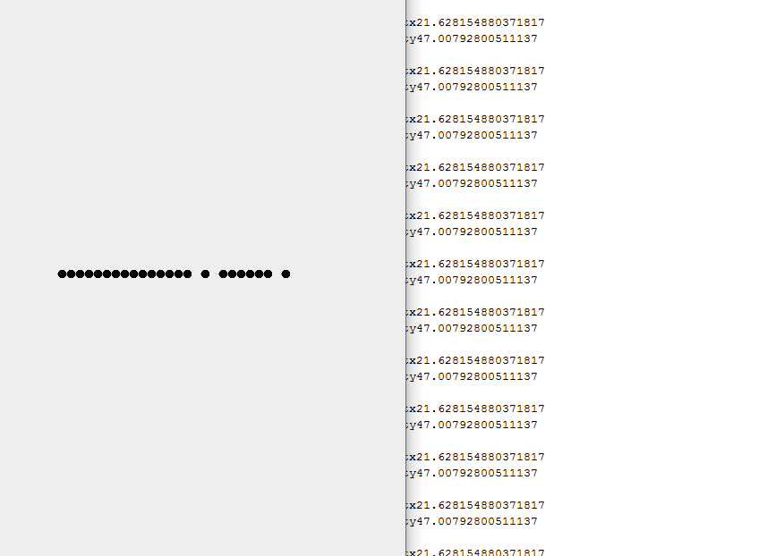
Sample results: test case 2
Before:
After:

